Slide 1
Lecture 14
Second-order Circuits (2)
Hung-yi Lee

Slide 2
Second-Order Circuits
Solving by differential equation

Slide 3
Second-order Circuits
Steps for solving by differential equation
  1. List the differential equation (Chapter 9.3)
  2. Find natural response (Chapter 9.3)
    There are some unknown variables in the natural response.
  3. Find forced response (Chapter 9.4)
  4. Find initial conditions (Chapter 9.4)
  5. Complete response = natural response + forced response (Chapter 9.4)
    Find the unknown variables in the natural response by the initial conditions

Slide 4
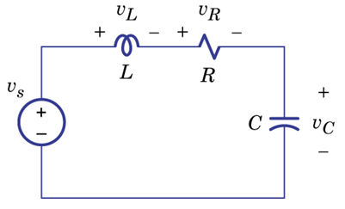
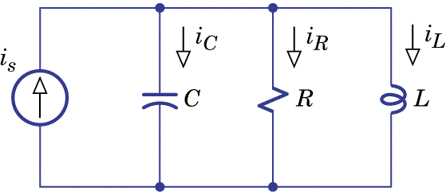
Review Step 1:
List Differential Equations

Slide 5
Review Step 2:
Natural Response
Overdamped
Real
Critical damped
λ₁, λ₂ is
Underdamped
Complex
Undamped

Slide 6
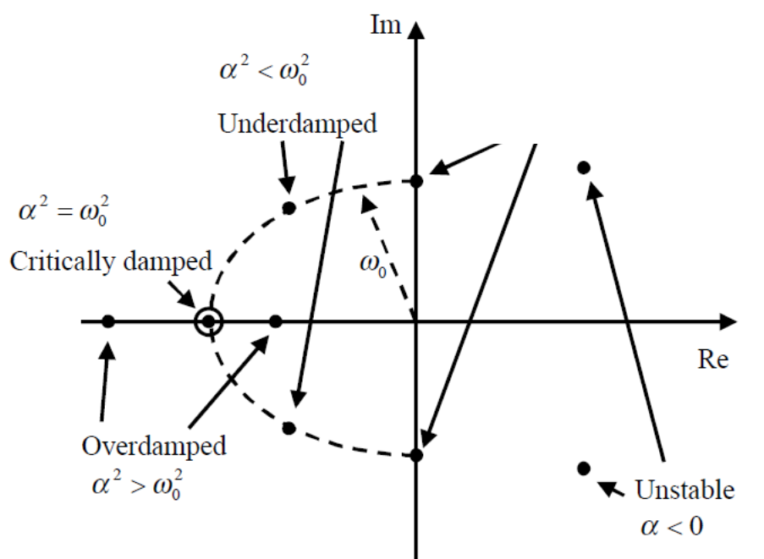
Fix ω₀, decrease α
The position of the two roots λ₁ and λ₂.
α=0
Undamped

Slide 7
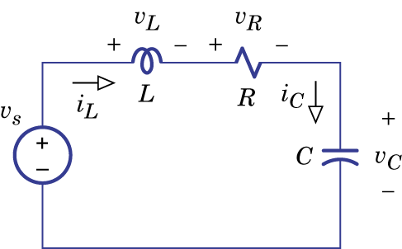
Example 9.11
Natural response i_{N}(t):

Slide 8
Example 9.11
Natural response i_{N}(t):
Forced response i_{F}(t)=0
Complete response i_{L}(t):
Two unknown variables, so two initial conditions.

Slide 9
Example 9.11
Initial condition
short
30V
open
Notes:
draw

Slide 10
Example 9.11
Notes:
What does it looks like?

Slide 11
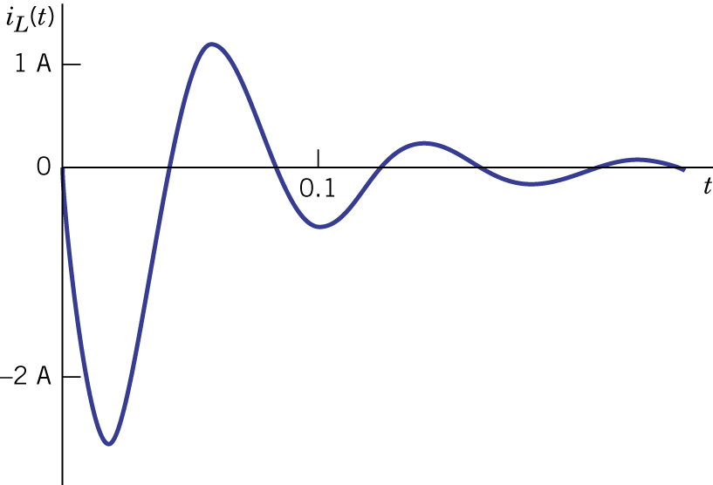
Example 9.11
Textbook:

Slide 12
Example 9.12
Natural response v_{N}(t):
Forced response v_{F}(t):

Slide 13
Example 9.12
Initial condition:
short
0V
open

Slide 14
Example 9.12
Initial condition:
Different R gives different response
Notes:
Is R>16 always stable?
Yes, if LC always >0
No, if LC can < 0

Slide 15
Example 9.12
Initial condition:
Overdamped:

Slide 16
Example 9.12
Initial condition:
Critical damped:

Slide 17
Example 9.12
Initial condition:
Underdamped:

Slide 18
Example 9.12
31.58
cos x
sin x
Notes:
Cos(a-b) = cos cos + sin sin
Show that x=-162
How about undampped

Slide 19
Example 9.12
Notes:
Tip: Check Your Results

Slide 20
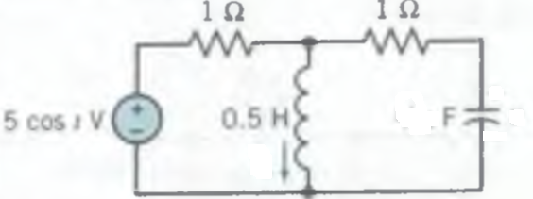
Non-constant Input
Find v_{c}(t) for t > 0 when v_{C}(0) = 1 and i_{L}(0) = 0

Slide 21
Non-constant Input
Natural response v_{N}(t):
Forced response v_{F}(t):

Slide 22
Non-constant Input
Initial Condition:

Slide 23
Non-constant Input

Slide 24
Second-Order Circuits
Zero Input + Zero State
& Superposition

Slide 25
Review: Zero Input + Zero State
y(t): voltage of capacitor or current of inductor
y(t) = general solution + special solution
=
=
= natural response + forced response
y(t) = state response (zero input)
+ input response (zero state)
Set sources to be zero
Set state v_{c}, i_{L} to be zero
= state response (zero input)
+ input 1 response + input 2 response ……
If input = input 1 + input 2 + ……

Slide 26
Example 1
(pulse)
Find v_{C}(t) for t>0
State response (Zero input):

Slide 27
Example 1
(pulse)
Find v_{C}(t) for t>0
State response (Zero input):
Notes:
Are there any thing wrong?

Slide 28
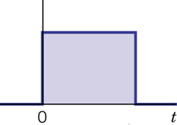
Example 1
(pulse)
Input response (Zero State):
Find v_{C}(t) for t>0
(set state to be zero)
-
…
…
=

Slide 29
Example 1
…
…
Notes:
We still have forced response!!!

Slide 30
Example 1
Input response (Zero State):
-
…
…
=

Slide 31
Example 1
Input response (Zero State):
-
…
…
=

Slide 32
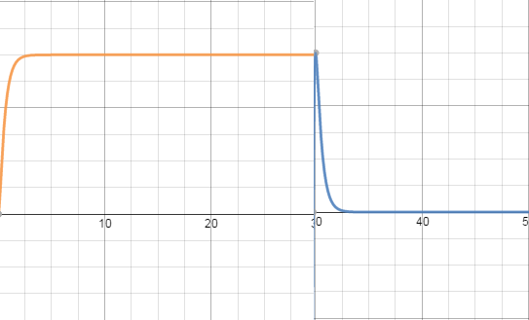
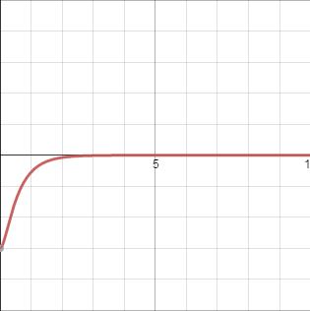
Example 1
Input response
(Zero State)
State response
(Zero input)

Slide 33
Example 1 – Differential Equation
(pulse)
Find v_{C}(t) for t>0
Assume 30s is large enough

Slide 34
Example 1 – Differential Equation

Slide 35
Example 1 – Differential Equation

Slide 36
Example 2
Find v_{C}(t) for t>0
State response (Zero input):
Changing the input will not change the state (zero input) response.

Slide 37
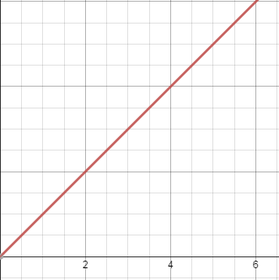
Example 2
Find v_{C}(t) for t>0
Input response (Zero state):
Input
(set state to be zero)
What is the response?
4 methods

Slide 38
Example 2 –
Method 1 for Zero State
Natural Response:
Forced Response:

Slide 39
Example 2 –
Method 1 for Zero State
Notes:
This is not the final

Slide 40
Example 2 –
Method 2 for Zero State
Find the response of each small pulse
Then sum them together

Slide 41
Example 2 –
Method 2 for Zero State
-
…
…
=

Slide 42
Example 2 –
Method 2 for Zero State
Consider a point a
value of the pulse at t₁ is
a

Slide 43
Example 2 –
Method 2 for Zero State
Consider a point a
value of the pulse at t₁ is

Slide 44
Example 2 –
Method 2 for Zero State
We can always replace “a” with “t”.

Slide 45
Example 2 –
Method 3 for Zero State
…
…
The value at time point a
…
…
…
…
a

Slide 46
Example 2 –
Method 3 for Zero State

Slide 47
Example 2 –
Method 4 for Zero State
Source Input:
Input (Zero State) Response
Source Input:
…
Input (Zero State) Response

Slide 48
Example 2 –
Method 4 for Zero State
Notes:
How we know a?

Slide 49
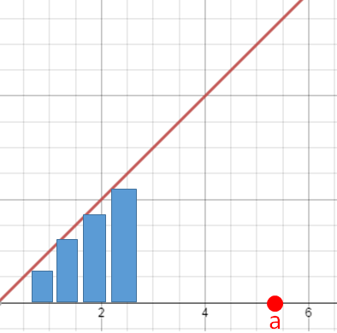
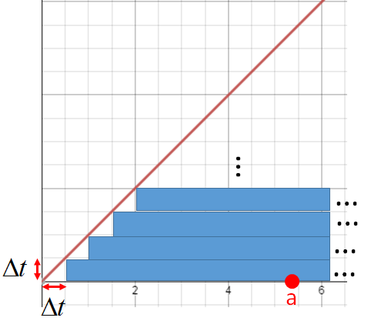
Example 2
Method 2:
Method 3:
Method 4:

Slide 50
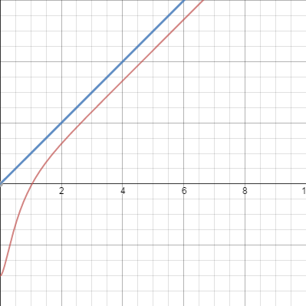
Example 2
Notes:
Reasonable!

Slide 51
Example 2 –
Checked by Differential Equation
Find v_{C}(t) for t>0
Notes:
A1+a2 = -19/8
2a1+8a2=1
2A1+2a2 = -19/4
6a2=23/4
A2 = 23/24
A1 = -19/8 - 23/24=-80/24=-10/3

Slide 52
Example 3
Find v_{C}(t) for t>0
How to solve it?
I will show how to solve the problem by
Method 1: Differential equation
Method 2: Integrating Step Responses
Method 3: Differentiate the sources

Slide 53
Example 3
– Method 1: Differential Equation
Find v_{C}(t) for t>0

Slide 54
Example 3
– Method 1: Differential Equation

Slide 55
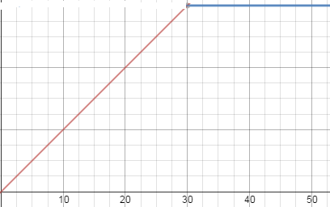
Example 3
– Method 2: Integrating Step Responses
…
…
…
…
…
…
The value at time point a
If a > 30
a
a
If a < 30
Integrating from 0 to a
If a > 30
Integrating from 0 to 30

Slide 56
Example 3
– Method 2: Integrating Step Responses

Slide 57
Example 3
– Method 3: Differentiate the sources
Response:
Response:

Slide 58
Example 3
– Method 3: Differentiate the sources
Response:

Slide 59
Example 3
– Method 3: Differentiate the sources
Response:

Slide 60
Announcement
11/12 (三) 第二次小考
  Ch5. Dynamic Circuit (5.3)
  Ch9. Transient response (9.1, 9.3, 9.4)
助教時間：週一到週五 PM6:30~7:30

Slide 61
Homework
9.58
9.60

Slide 62
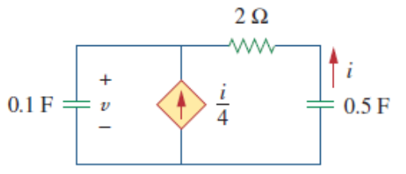
Homework
Find v(t) for t>0 in the following circuit. Assume that v(0⁺)=4V and i(0⁺)=2A.

Slide 63
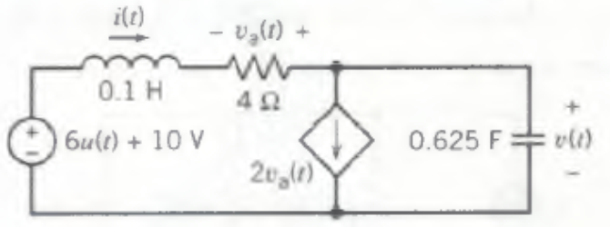
Homework
Determine v(t) for t>0 in the following circuit

Slide 64
Thank You!

Slide 65
Homework
9.58
9.60

Slide 66
Homework
Find v(t) for t>0 in the following circuit. Assume that v(0⁺)=4V and i(0⁺)=2A.

Slide 67
Homework
Determine v(t) for t>0 in the following circuit

Slide 68
Appendix

Slide 69
Higher order?
All higher order circuits (3rd, 4th, etc) have the same types of responses as seen in 1st-order and 2nd-order circuits

Slide 70
Acknowledgement
  感謝不願具名的同學
  指出投影片中 Equation 的錯誤
  感謝 吳東運(b02)
  指出投影片中 Equation 的錯誤
  感謝 林裕洲 (b02)
  發現課程網站的投影片無法開啟

